Slide 1

Actuarial Predictive Modeling
Joe Warth ‘13

Slide 2


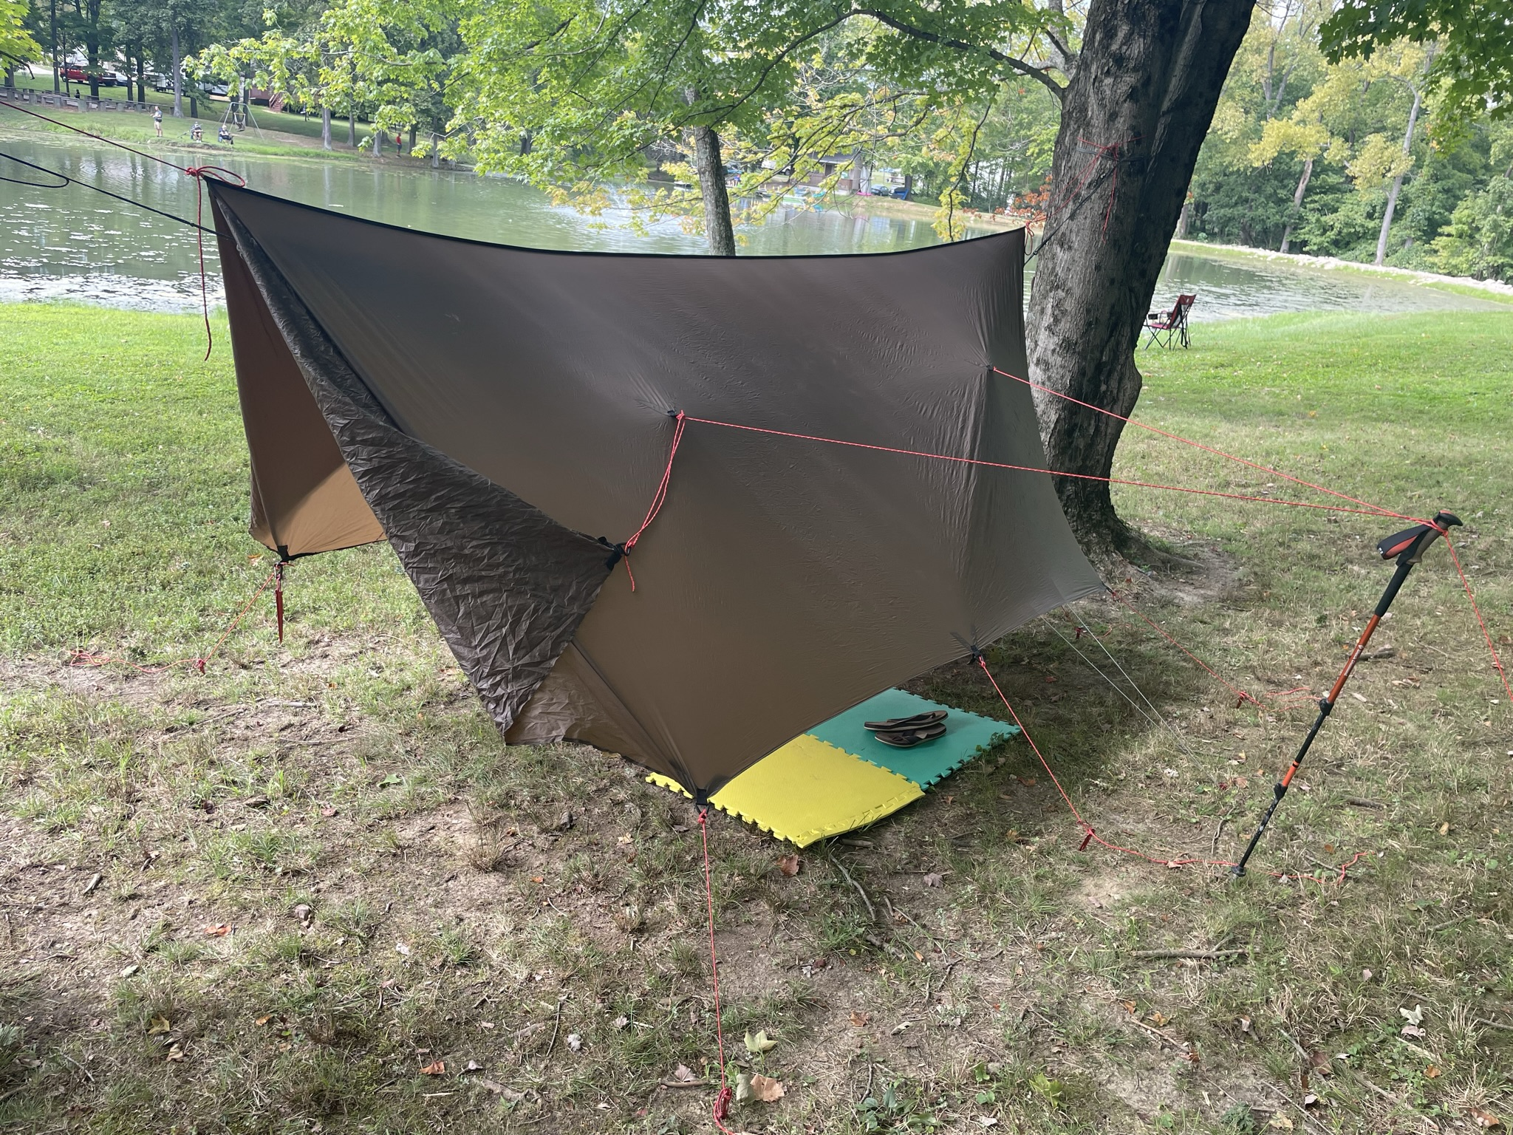






About Me

Slide 3
Before We Begin
Where this fits
ACAS & FCAS Exam Track
MAS-I & II: predictive modeling methods
Exam 5: Ratemaking Basics
PCPA Module: GLMs
Exam 8: Advanced Ratemaking & Modeling
Python: Not covered in exams
What I knew in 2013
Basic terminology
Did NOT know most of this material
Learned it gradually on the job
For Today
Only have about 45 minutes
Moving quickly, covering too much
This is what I wish I knew about before I started working
Please stop me with questions
Goal: Understand the business problem and the modeling intuition- not understand every detail

Slide 4
Insurance 101: Terminology
Customers pay Premium before we know what the policy will ultimately cost. During the Exposure period, a covered event may produce a Claim and a resulting Loss. The insurer incurs Expense to operate as a business
Premium
Amount charged for the policy
Exposure
Unit of risk over a period of time
Claim
Covered event reported to the insurer
Loss
Cost of resolving a claim
Expense
Cost of operating the insurance business

Slide 5
Key Metrics for Modeling
Core metrics
How basic insurance measures become business metrics and modeling targets
Different questions Different targets
A model starts with a business question, not the algorithm
Pricing
Estimate expected cost of future policies
Pure Premium
Frequency & Severity separately, multiply
Reserving
Estimate ultimate cost of claims that have already occurred
Ultimate loss
Remaining loss
Underwriting / Risk Selection
Identify accounts that may require additional attention
Claim Probability
Large-loss probability
Expected Loss
Expected Loss Ratio
Frequency | Claim Count / Exposure How often claims occur
Severity | Loss / Claim Count Average cost when a claim occurs
Pure Premium (aka Loss Cost) | Loss / Exposure = Frequency * Severity Expected loss per exposure
Loss Ratio | Loss / Premium Share of premium is used to pay losses
Expense Ratio | Expense / Premium Share of premium is used to pay expenses
Combined Ratio | (Loss + Expense) / Premium = Loss Ratio + Expense Ratio Overall measure of underwriting profitability

Slide 6
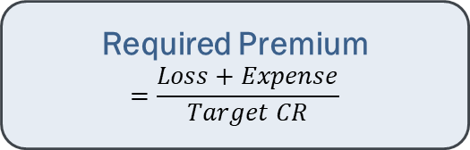
What Price to Charge?
Estimate future Loss & Expense and choose a target Combined Ratio
Solve for the Premium needed to support those expected costs
Example, cont’d: If Exposure = 400, then Average Premium = $1.0M / 400 = $2,500 per Exposure. How to achieve?
Key questions: Which is better? If Option 2, how do we determine who is lower or higher risk- and exactly how much to charge?
1
2
Required Premium
$$=\frac{Loss+Expense}{Target CR}$$
Example
Loss = $650K | Expense = $300K | Target CR = 95%
Required Premium = (650K + 300K) / 0.95 = $1.0M
3
Option 1: Flat Price
Everyone pays $2,500
Simple, but ignores risk differences
Option 2: Segmented Price
Charge $2,500 on average, but vary price by risk level
Lower-risk customers pay less; higher-risk customers pay more

Slide 7
Adverse Selection: A Simple Marketplace Example
Assumptions
Carriers: Two companies with the same expenses, profit targets, and customer experience
Customers: Two risk groups: lower risk and higher risk
Expected Cost: Good customers cost $2,000 per exposure; Bad customers cost $3,000
Market Mix: 80% lower risk; 20% higher risk
Behavior: Customers know both prices and choose the cheaper option
 | Company A | Company B
Pricing | Flat $2,200 per exposure (Weighted Average) | $2,000 for Good; $3,000 for Bad
Customer choice | Looks cheapest to Bad customers | Looks cheapest to Good customers
Outcome | Attracts underpriced Bad customers and loses money | Attracts Good customers and prices them adequately
Takeaway: When everyone is charged the same average price, the customers you underprice are more likely to choose you.
Real life is much more complicated: there are many insurers, many levels of risk, different expenses and profit targets, imperfect information, and customers do not always choose solely on price.
But the core idea still holds: better risk segmentation helps reduce adverse selection, even when it is much harder to observe and measure.
This is what I do: build models that estimate expected future loss at the individual exposure level so we can better segment risk, set more appropriate prices, and reduce adverse selection.

Slide 8
Case Study: French Motor Liability Claims
Modeling Demo in Python

